Slide 1
Catering Reservation and Ordering System
Adhiyamaan college of engineering
Vidhya shree . c

Slide 2
abstract
The true purpose of the project will be able to develop a full-fledged online food ordering system in the food industry. Businesses will be able to maintain an online flexible menu with such a system, and customers could browse this menu and place their orders with just a few clicks. The online or cash order has to be made by the customer.
The customer will be in a position to view the products, register and place an order.
Online Food Ordering is a form of electronic shopping store where is directly online to the seller's computer usually via the Internet. There is no intermediary service.
The sale and purchase transaction is completely electronically and interactively in real-time.
The development of this new system contains the following activities, which try to develop on-line application by keeping the whole process in the view of database integration approach. User gets their email id and password to access their account.
An Online Ordering Food System is proposed here, which decouples the food ordering process.
The proposed system exhibits a user interface and updates the menu with all available options to make it easy for the customer.
Customers can effectively make an order by selecting more than one item, and they are presented with the order details.
The confirmation of the order takes place that goes to the customer. The status of the placed order can be checked and updated into a real-time database and retrieved.

Slide 3
Scope of the project
Online food ordering system will be a web-based application whose main language of programming will be HTML.
Its main aim to simplify and improve the efficiency of the ordering process for both customer and our restaurant, minimize manual data entry and ensure data accuracy and security during order placement process. Customer will also be able to view product meus and their ingredients and be able to have a visual confirmation that the order was place correctly

Slide 4
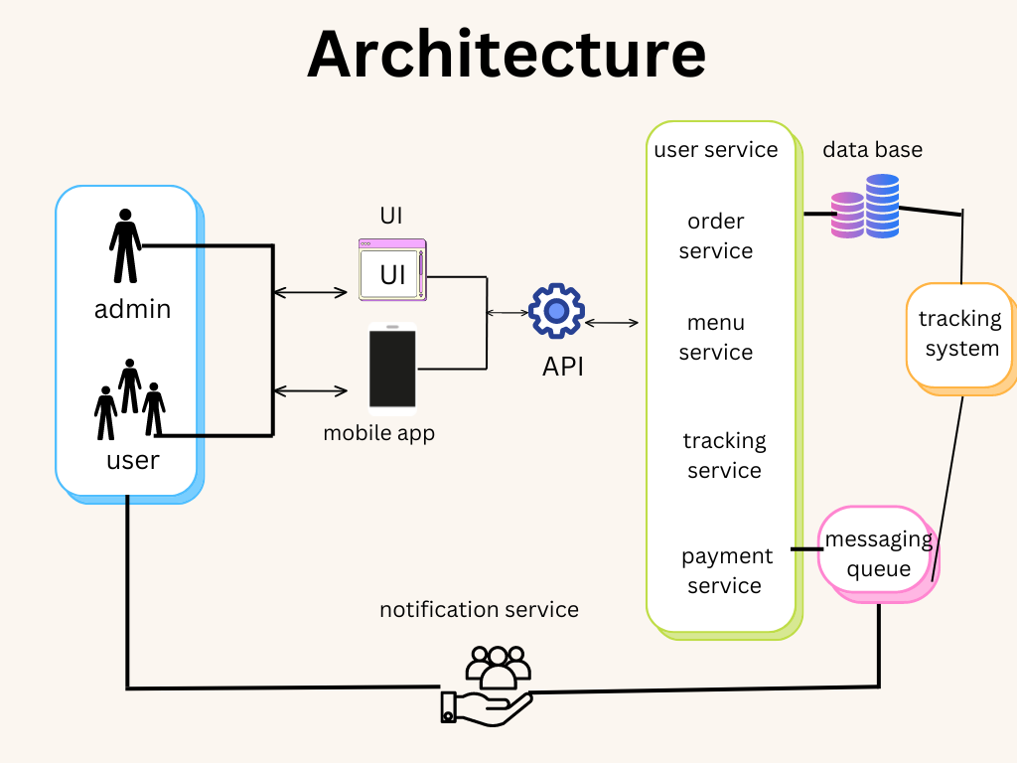

Slide 5
Features in admin panel :
Restaurant management: The admin can directly manage all the restaurants by adding, updating, and removing any eating joint from the list. They can also check the active status of the restaurants. This feature allows the admin to keep track of the currently active restaurants on the platform and make changes as necessary.
Analytics & report generation: Using analysis and report features, the admin can get real-time insights into reports and other accounting information, which helps to identify the growth and opportunities to expand reach. This feature provides the admin with valuable data and metrics that Analytics & report generation can use to make informed decisions about the direction of the platform.
Monitoring every action: The admin can monitor all the food orders, delivery partners, deliveries, reviews & ratings of delivery partners, canceled orders, and other vital data related to the driver's performance. This feature allows the admin to keep track of various aspects of the platform's operation and make any necessary adjustments to improve performance. The monitoring feature also helps ensure that the platform runs smoothly and that customer service is up to part.

Slide 6
Customer panel:
The customer app offers a variety of features to make ordering food and tracking deliveries easy and convenient for users. These include:
The ability to search for restaurants and cafes by location and cuisine, using a search filter to find desired options quickly.
An ordering system allows users to select dishes and proceed to checkout with options for delivery time.
Real-time tracking of delivery partners so that users can see the location of their driver and estimated delivery time.
Integration with various payment methods, including credit/debit cards and popular digital wallets.

Slide 7
Application Flow
Different services are connected via an API gateway. This gateway handles load balancing and routing requests to the appropriate services, authenticating and authorizing users and sending back a token ID for further communication.
Services such as user registration, order management, and payment management use transactional databases. The system will use a relational database, a highly scalable service that can manage concurrent orders and users.
Information about restaurants, menus, prices, and offers will be stored in Elastic Search, a JSON document storage that provides fast and scalable search options. This allows customers to search for menus and cuisines quickly.
The ordering process includes selecting dishes, calculating prices, and processing payments through different payment gateways and options. Once an order is successfully placed, the information is sent to a central message queue.
The order processing unit reads the order information, notifies the selected restaurant, and searches for available delivery partners nearby.

Slide 8
Project goals
Promote Rural Catering: Provide a platform for rural towns to sell their catering commodities to a global market, promoting local talent and traditional Indian culture.
Secure Product Management: Allow administrators to manage product information securely using mobile devices.
User-Friendly Interface: Design an intuitive and user-friendly interface for customers to browse and purchase catering services

Slide 9
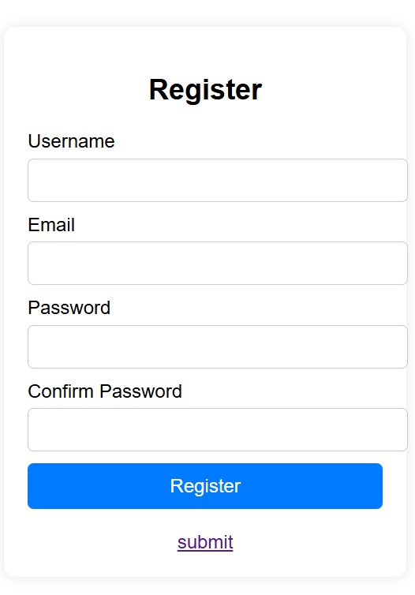
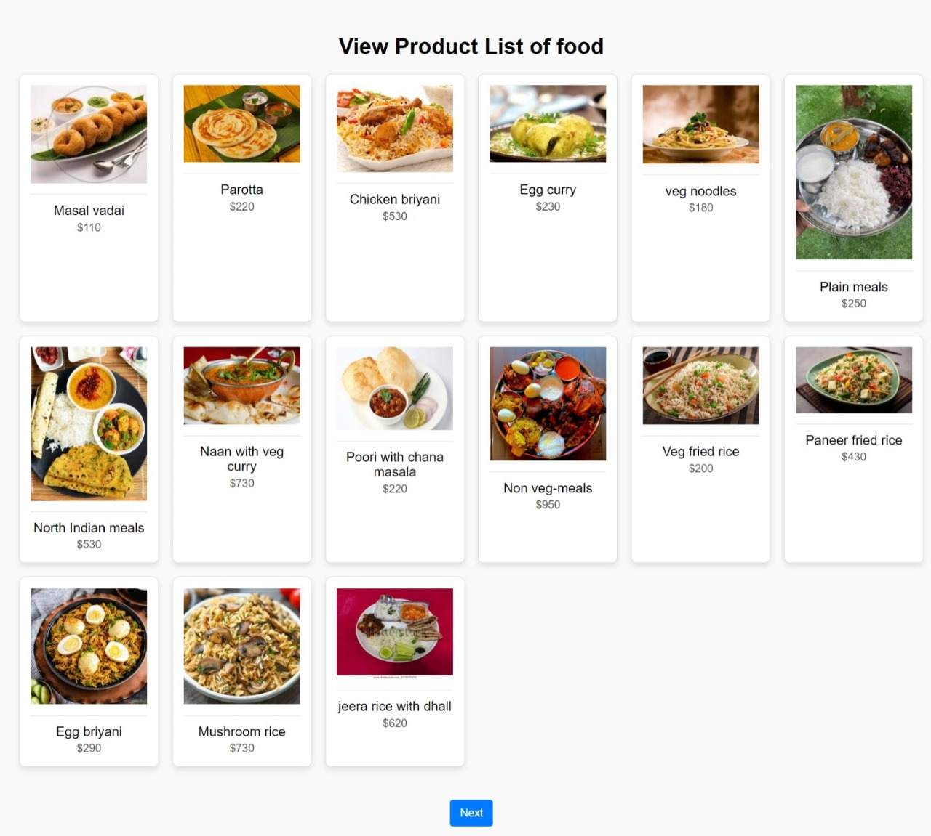
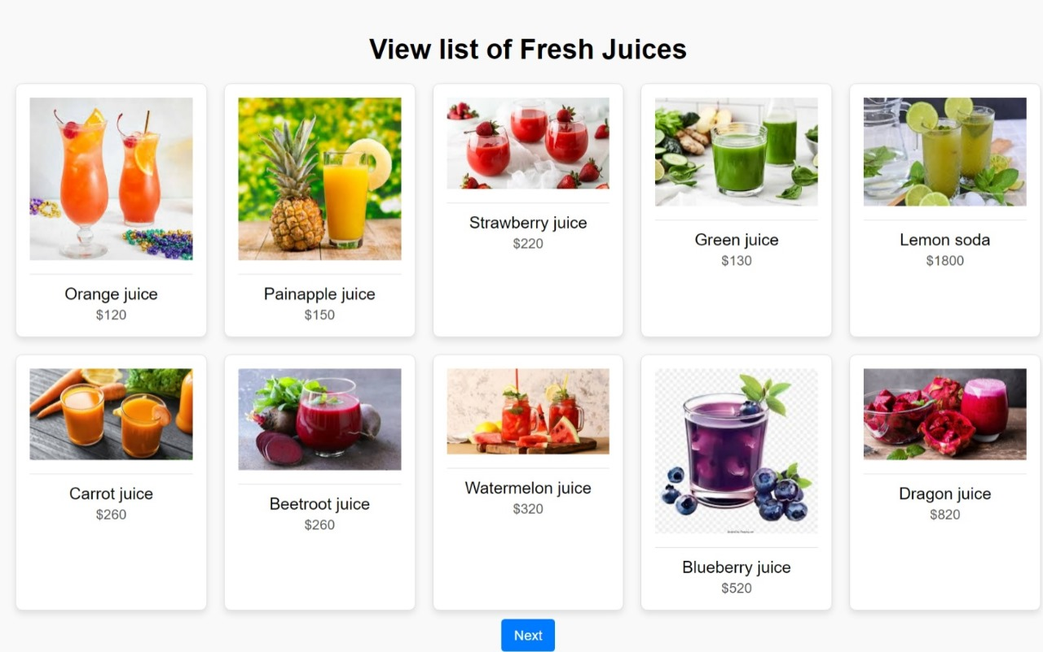
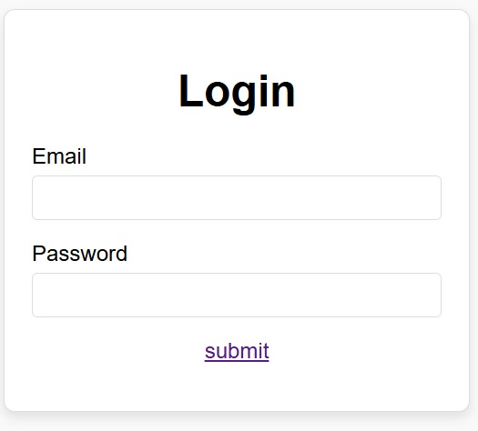
1.
3.
3.
2.

Slide 10
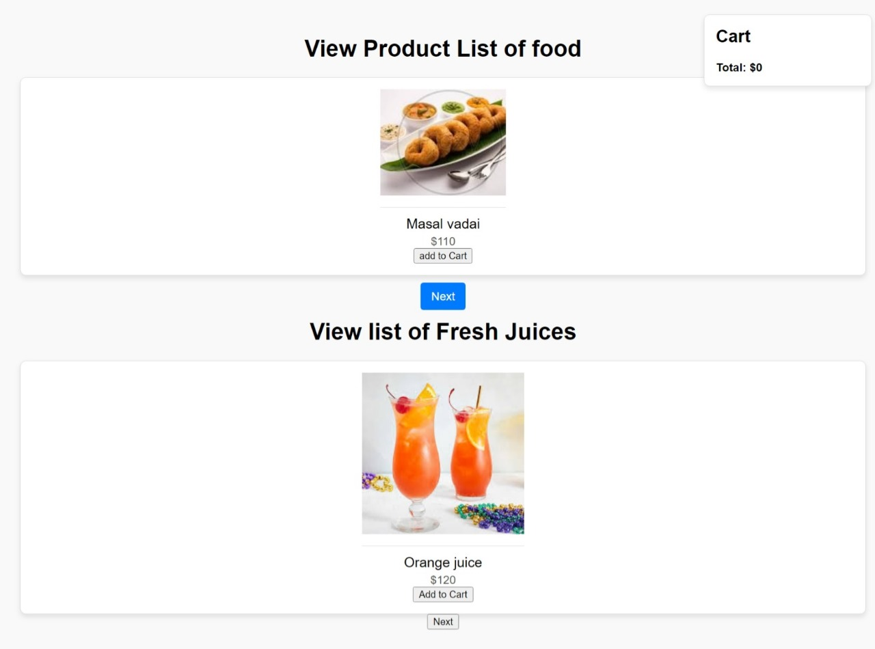
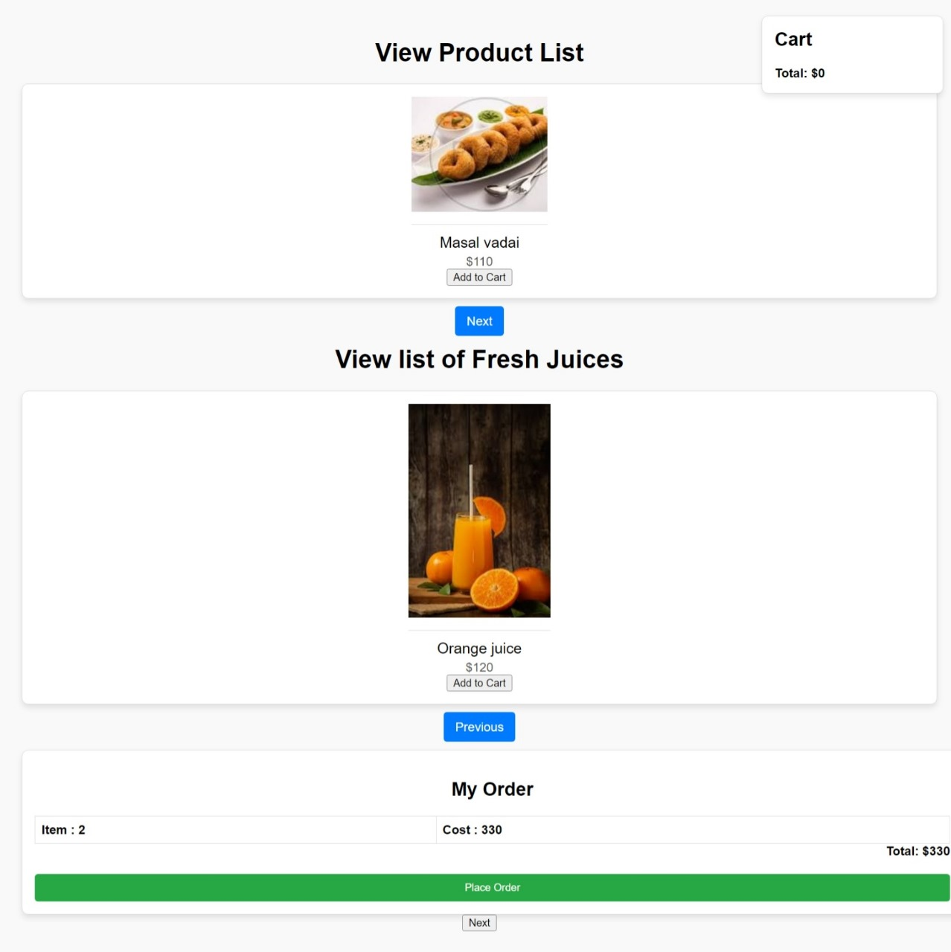
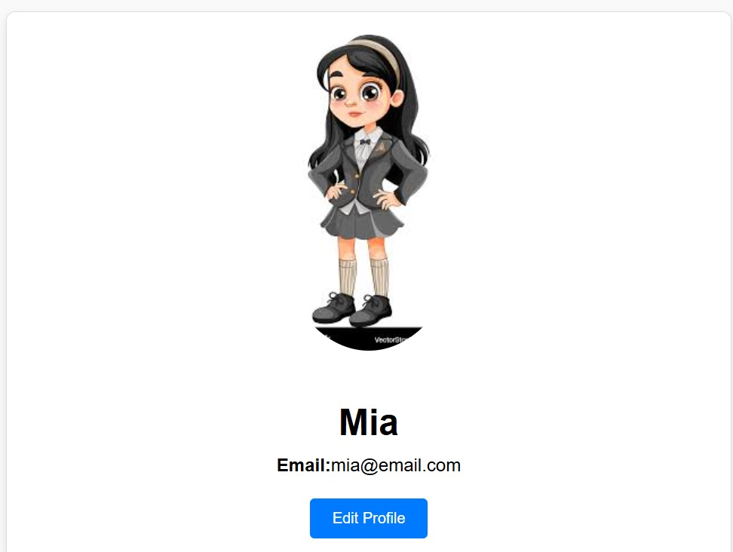
5.
7.
6.
8.

Slide 11
Conclusion :
This project report outlines the vision, objectives, features, and implementation plan for the Catering website, highlighting its potential to revolutionize the way rural towns sell their catering products on a global scale.

